Slide 1
COMP 469
Chapter 2: Intelligent Agents
CSU Channel Islands · Department of Computer Science
Sense
Decide
Act
Core question: how should an agent choose actions in an environment?
Notes:
Open by linking Chapter 1 to Chapter 2. Chapter 1 ended with the rational-agent approach: AI is about systems that do the right thing. Chapter 2 makes that concrete by defining the agent, the environment, rational behavior, and agent program designs. Tell students that this chapter is the conceptual foundation for search, planning, probability, machine learning, and reinforcement learning later in the course.
[Sources]
Uploaded Chapter_2(4).docx, Chapter 2 opening and Section 2.1.

Slide 2
What Can AI Do?
Warm-up
Reliable in formal worlds
Harder in open worlds
Teaching move
Win at chess or Go
Translate speech
Classify images
Answer structured questions
Drive safely in all conditions
Unload any dishwasher in any home
Buy groceries in a physical store
Act with incomplete information
Do not ask only whether AI “can” do something. Ask what the environment is, what the agent can perceive, what actions are available, and how success is measured.
Task difficulty depends on environment structure.
Use this as a quick poll before formal definitions.
COMP 469 · Chapter 2
2
Notes:
Start with a capability quiz. Ask students which tasks they think current AI can do reliably. The purpose is to make students notice that task difficulty depends on the environment. Chess and Go have clean rules, full state representation, and limited actions. A dishwasher in an arbitrary home is physically messy, partially observable, and highly variable. This naturally leads into Chapter 2: define the agent, environment, percepts, actions, and performance measure before choosing an algorithm.
[Sources]
Uploaded Chapter_2(4).docx, Section 2.1 and Section 2.3.

Slide 3
A Rational-Agent Perspective
Framing
Should we make machines that...
Think like people
Think rationally
human thought process
formal reasoning
Act like people
Act rationally
human-like behavior
choose effective actions
COMP 469 · Chapter 2
3
Notes:
Use this slide to connect Chapter 1 and Chapter 2. Chapter 1 introduced the rational-agent approach. Chapter 2 operationalizes it: design systems that perceive and act to maximize expected performance. In this course we are not primarily trying to copy human thought or imitate human behavior. We are trying to build agents that choose actions that work.
[Sources]
Uploaded Chapter_2(4).docx, Chapter 2 opening.

Slide 4
2.0 Roadmap: From Agent Loop to Agent Design
Roadmap
Agent loop
Rationality
PEAS
percepts -> action
expected performance
task specification
Environment
Agent types
Representation
what makes it hard
table-driven -> learning
how the world is encoded
Teaching flow: intuition -> formal model -> environment classification -> agent architecture -> demo.
COMP 469 · Chapter 2
4
Notes:
Chapter 2 is not one algorithm. It is a design framework. First, describe the interaction loop. Second, define rational behavior. Third, specify the task using PEAS. Fourth, classify the environment. Fifth, choose an agent program design. Finally, discuss learning and representation choices.
[Sources]
Uploaded Chapter_2(4).docx, Sections 2.1-2.4 and Summary.

Slide 5
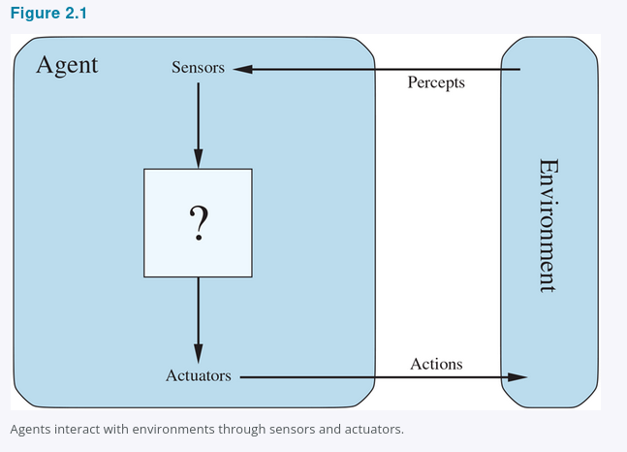
2.1 Agents and Environments: The Perceive-Act Loop
2.1
Examples
Human: eyes/ears -> hands/voice
Robot: camera/lidar -> motors
Software: packets/input -> files/network
Figure 2.1
COMP 469 · Chapter 2
5
Notes:
Read this as the central diagram of the chapter. An agent is anything we can view as perceiving an environment through sensors and acting on that environment through actuators. The environment is the part of the world that matters for this agent design: the part that affects the agent’s percepts and is affected by its actions.
[Sources]
Uploaded Chapter_2(4).docx, Section 2.1 and Figure 2.1.

Slide 6
2.1 From Percepts to Agent Functions
2.1
Percept
Percept sequence
Agent function
Agent program
Current sensor content.
Example: current Pac-Man tile, nearby wall, visible ghost.
Complete history of everything the agent has perceived.
Abstract mapping:
percept sequence -> action
Concrete implementation running on an architecture.
percept sequence
action
Do not confuse these two:
Agent function = external mathematical description of behavior
Agent program = internal code that receives current percept and returns an action
Chapter 2 problem: produce rational behavior from a compact program, not a vast lookup table.
COMP 469 · Chapter 2
6
Notes:
A percept is what the sensors are currently receiving. A percept sequence is the entire history. The agent function is an abstract mapping from possible percept sequences to actions. The agent program is the concrete implementation. The program usually receives only the current percept, so if the action depends on history, the program must store that history internally.
[Sources]
Uploaded Chapter_2(4).docx, Section 2.1.

Slide 7
2.2 Good Behavior: Rationality Is Expected Performance
2.2
A rational agent selects the action expected to maximize its performance measure.
Performance measure
Prior knowledge
What counts as success?
What does the agent already know?
Available actions
Percept sequence
What can the agent actually do?
What evidence has it observed?
Rationality is not hindsight perfection. It uses evidence available at the time.
COMP 469 · Chapter 2
7
Notes:
Chapter 2 evaluates behavior by consequences. The performance measure defines success. Rationality depends on four things: the performance measure, prior knowledge, available actions, and the percept sequence. Stress that rationality is not being lucky or being correct after the fact. It is maximizing expected performance given evidence and knowledge.
[Sources]
Uploaded Chapter_2(4).docx, Section 2.2.

Slide 8
2.2 Performance Measures: Be Careful What You Ask For
2.2
Bad measure
Better measure
Reward the vacuum for amount of dirt cleaned.
Failure mode: dump dirt, clean it, dump it again.
Reward clean squares over time.
Measure the environment outcome, not the agent’s visible effort.
General lesson
Design performance measures according to what you actually want achieved in the environment.
Connection to Chapter 1: wrong objectives create the King Midas / value-alignment problem.
COMP 469 · Chapter 2
8
Notes:
Use the vacuum example to show objective misspecification. Rewarding “amount of dirt cleaned” creates an incentive to dump dirt and clean it repeatedly. A better measure rewards clean squares over time, possibly with penalties for electricity or noise. The design principle is to measure what we actually want achieved in the environment, not a proxy for visible effort.
[Sources]
Uploaded Chapter_2(4).docx, Section 2.2.1.

Slide 9
2.2 Rationality Is Not Omniscience
2.2
Omniscience
Rationality
Autonomy
Knows the actual outcome of every action. Impossible in realistic environments.
Chooses the action with best expected performance from available evidence.
Learns from percepts rather than depending only on designer assumptions.
Look
Learn
Act
Improve
Information gathering is rational when better percepts improve later decisions.
COMP 469 · Chapter 2
9
Notes:
Rational agents do not need omniscience. Omniscience means knowing actual outcomes. Rationality means making the best expected choice using available evidence. Information gathering is part of rationality because looking before crossing changes future percepts. Learning is also part of autonomy: the agent should use experience to compensate for incomplete or incorrect prior knowledge.
[Sources]
Uploaded Chapter_2(4).docx, Section 2.2.3.

Slide 10
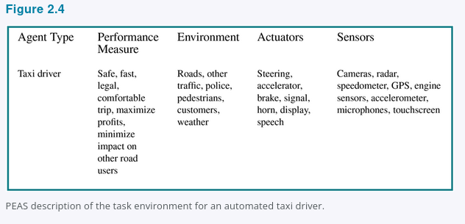
2.3.1 PEAS: Specify the Task Before Designing the Agent
2.3.1
PEAS = Performance measure, Environment, Actuators, Sensors
P
E
A
S
Performance
Environment
Actuators
Sensors
Safe, fast, legal, comfortable trip; minimize time/cost; maximize profit
Roads, traffic, pedestrians, weather, passengers, police, construction
Steering, accelerator, brake, signals, display, speech
Cameras, lidar, radar, GPS, speedometer, engine sensors, voice/touch input
Design rule: specify the task environment as fully as possible first.
Figure 2.4
COMP 469 · Chapter 2
10
Notes:
PEAS is a design checklist. The automated taxi is the main Chapter 2 example. Performance includes safety, legality, comfort, time, cost, fuel use, and profit; these can conflict. The environment includes roads, traffic, pedestrians, weather, and passengers. Actuators include steering, accelerator, brake, display, and speech. Sensors include cameras, lidar, radar, GPS, speedometer, engine sensors, and passenger input.
[Sources]
Uploaded Chapter_2(4).docx, Section 2.3.1 and Figure 2.4.

Slide 11
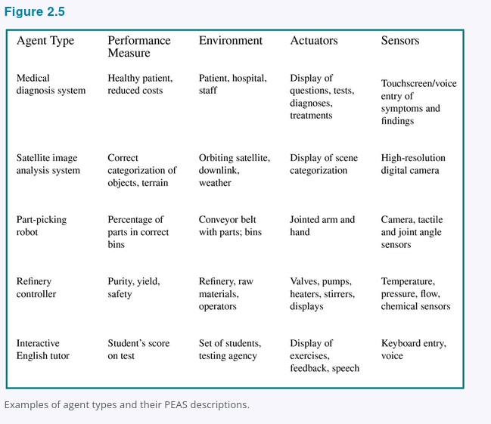
2.3.1 PEAS Examples: Agent Types and Task Environments
2.3.1
PEAS forces the designer to specify success, the world, available actions, and perceptual inputs before choosing an algorithm.
Design checkpoint: if PEAS is vague, the agent design will be vague.
Figure 2.5
COMP 469 · Chapter 2
11
Notes:
This slide expands PEAS beyond the taxi. Figure 2.5 includes medical diagnosis, satellite image analysis, part-picking robots, refinery controllers, and interactive English tutors. The teaching point is that PEAS is not busywork. It determines the problem. Before students propose search, learning, planning, or rules, they must specify the performance measure, environment, actuators, and sensors.
[Sources]
Uploaded Chapter_2(4).docx, Section 2.3.1 and Figure 2.5.

Slide 12
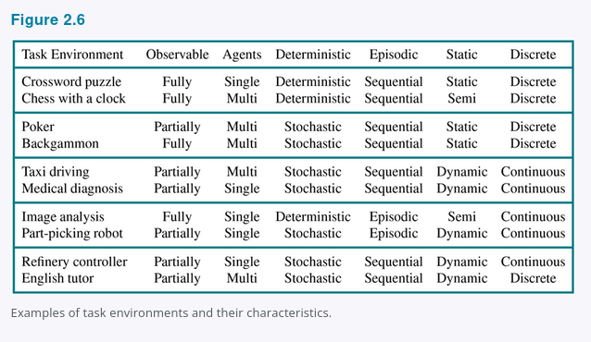
2.3.2 Task Environment Properties
2.3.2
Observable
Agents
Transition
Episodes
Fully <-> Partially
Single <-> Multi
Deterministic <-> Nondeterministic / stochastic
Episodic <-> Sequential
Time
State/action
Knowledge
Static <-> Dynamic / semidynamic
Discrete <-> Continuous
Known <-> Unknown
Hardest case: partially observable, multiagent, nondeterministic, sequential, dynamic, continuous, unknown.
Figure 2.6
COMP 469 · Chapter 2
12
Notes:
Use this slide as a diagnostic tool. Environment properties determine the right agent design. Fully observable means sensors provide relevant state; partially observable means state is missing or noisy. Multiagent environments require modeling other agents. Deterministic environments have predictable next states; stochastic environments require uncertainty handling. Episodic tasks do not require long-term consequences; sequential tasks do. Static environments do not change while the agent deliberates; dynamic ones do.
[Sources]
Uploaded Chapter_2(4).docx, Section 2.3.2 and Figure 2.6.

Slide 13
Pac-Man as a Chapter 2 Agent
Example
Sensors / percepts
Walls, pellets, ghost positions, legal moves, power-pellet status.
Actions / actuators
Move left, right, up, or down. Action changes the maze state.
Performance
SCORE: 0
Maximize score; eat pellets; avoid ghosts; use power pellets safely.
Environment
Sequential, dynamic, multiagent, discrete grid; partially observable in richer versions.
Class demo: the autonomous Pac-Man game implements this loop in code.
COMP 469 · Chapter 2
13
Notes:
Pac-Man is a strong teaching example because the environment, percepts, actions, and performance measure are visible. The agent senses walls, pellets, ghost positions, legal moves, and whether power mode is active. The actions are movement choices. The task is sequential because current choices affect future survival, multiagent because ghosts behave as other entities, and dynamic because ghosts move while Pac-Man plays.
[Sources]
Uploaded Chapter_2(4).docx, Sections 2.1-2.4.

Slide 14
2.4 Agent Structure: Architecture + Program
2.4
agent = architecture + program
Architecture
Agent program
Agent function
Physical or computational platform: sensors, processors, memory, actuators.
Software that receives percepts and returns actions.
Behavior implemented by the program: percept sequence -> action.
Why not use a giant lookup table?
Too many percept sequences to store.
Too much work for the designer to fill in.
Too much experience for the agent to learn every entry.
AI problem: produce rational behavior from a compact program, not a vast table.
COMP 469 · Chapter 2
14
Notes:
Chapter 2 gives the formula agent equals architecture plus program. The architecture makes percepts available and carries actions out through actuators. The program implements the agent function. A table-driven agent is conceptually useful but practically impossible because the table grows explosively with percept history.
[Sources]
Uploaded Chapter_2(4).docx, Section 2.4 and 2.4.1.

Slide 15
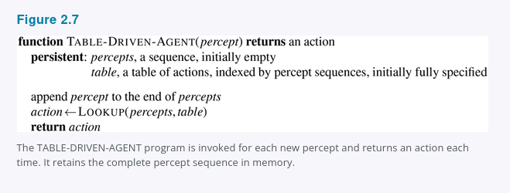
2.4.1 Table-Driven Agent
2.4.1
A table-driven agent stores the entire percept sequence and indexes a table of actions.
What it demonstrates
The agent function can be represented explicitly as a mapping from percept history to action.
Why it matters
It is correct in principle if the table is filled correctly, but it is usually infeasible.
Term to know
Table-driven agent: the simplest conceptual agent program in Section 2.4.1.
Figure 2.7
COMP 469 · Chapter 2
15
Notes:
This is the table-driven agent, the “driven agent” you wanted explicitly covered. It keeps the complete percept sequence and uses it to look up an action. It is conceptually useful because it shows an agent program implementing an agent function. It is not practical for real agents because the table becomes enormous. Show the pseudocode screenshot and emphasize that it retains the complete percept sequence in memory.
[Sources]
Uploaded Chapter_2(4).docx, Section 2.4.1 and Figure 2.7.

Slide 16
Why Table-Driven Agents Fail in Practice
2.4.1
The lookup table grows with every possible percept sequence.
Space problem
Design problem
Learning problem
No physical agent can store every entry for a realistic environment.
No designer can fill in the right action for every possible sequence.
No agent can experience every possible percept sequence.
Key challenge for AI
Write small programs that produce rational behavior without enumerating every possible history.
COMP 469 · Chapter 2
16
Notes:
The table-driven agent does what we want if the table is correct, but Chapter 2 uses it to show why AI needs compact programs. The lookup table grows across possible percept histories. Realistic environments make the table too large to store, too hard for a designer to fill in, and too large for an agent to learn through experience.
[Sources]
Uploaded Chapter_2(4).docx, Section 2.4.1.

Slide 17
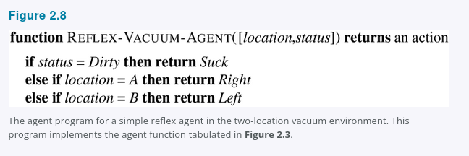
2.4.2 Simple Reflex Agents: Vacuum Pseudocode
2.4.2
Select an action from the current percept only.
Vacuum rule
if status = Dirty then Suck
else if location = A then Right
else if location = B then Left
Why this is reflex
The action depends only on current location and dirt status, not the entire percept history.
Strength: fast and compact. Weakness: brittle when the current percept is incomplete.
Figure 2.8
COMP 469 · Chapter 2
17
Notes:
A simple reflex agent selects actions using the current percept only. In the vacuum world, this can work if the agent perceives both location and dirt status. The screenshot shows REFLEX-VACUUM-AGENT. It is far smaller than a full percept-history lookup table because it ignores history and uses a compact condition-action structure.
[Sources]
Uploaded Chapter_2(4).docx, Section 2.4.2 and Figure 2.8.

Slide 18
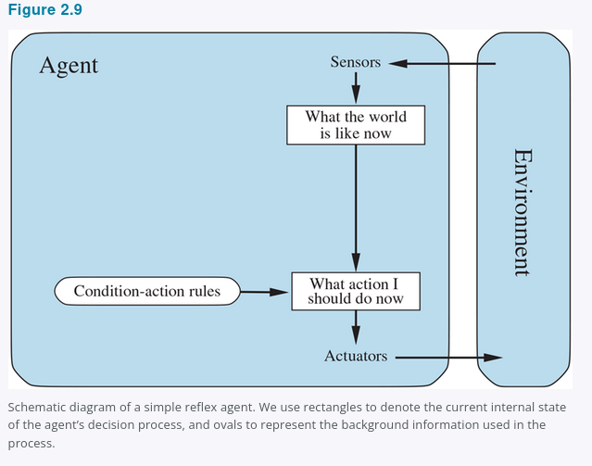
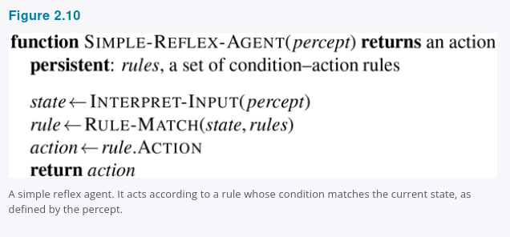
2.4.2 General Simple Reflex Agent
2.4.2
General pattern
Interpret current percept -> match condition-action rule -> return rule action.
Key limitation
If the current percept does not reveal enough state, the rule may choose the wrong action.
Figures 2.9 and 2.10
COMP 469 · Chapter 2
18
Notes:
The general simple reflex agent uses condition-action rules. The INTERPRET-INPUT function creates an abstract state description from the current percept. RULE-MATCH finds the first rule matching that state, and the action is returned. The chapter stresses that rules and matching are conceptual; the implementation could be logic gates or neural units.
[Sources]
Uploaded Chapter_2(4).docx, Section 2.4.2, Figure 2.9, and Figure 2.10.

Slide 19
When Simple Reflex Fails: Partial Observability
2.4.2
Problem
Vacuum example
Temporary fix
The current percept does not contain enough information to choose correctly.
If the agent sees only Clean/Dirty but not location, moving Left or Right can loop forever.
Randomization can sometimes escape loops, but it is not general intelligence.
Better solution: maintain internal state or use a model of the world.
percept
memory
model
action
COMP 469 · Chapter 2
19
Notes:
Ask students what happens if the vacuum cannot perceive location. If the only percept is Clean or Dirty, Clean does not identify the square. A deterministic rule can loop forever. Randomization may help in this toy case, but Chapter 2 says we usually do better with model-based agents that maintain internal state.
[Sources]
Uploaded Chapter_2(4).docx, Section 2.4.2.

Slide 20
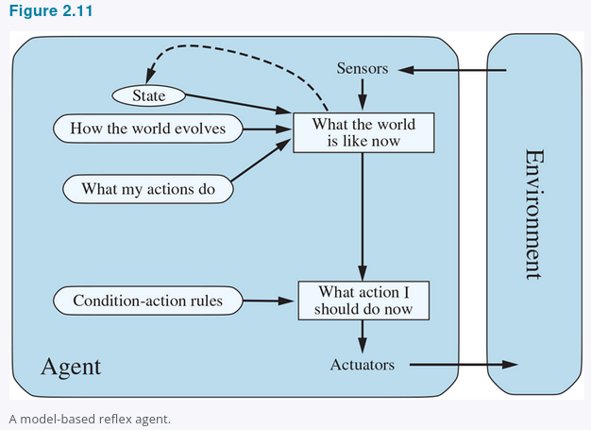
2.4.3 Model-Based Reflex Agents
2.4.3
Maintain internal state: a best guess about what the world is like now.
Transition model
How the world changes over time and how actions affect it.
Sensor model
How world states generate percepts.
Internal state
Tracks what is not evident in the current percept.
Figure 2.11
COMP 469 · Chapter 2
20
Notes:
Model-based reflex agents handle partial observability by maintaining internal state. The state is the agent’s best guess about the current world. Updating the state requires a transition model, which says how the world changes and what actions do, and a sensor model, which says how states are reflected in percepts.
[Sources]
Uploaded Chapter_2(4).docx, Section 2.4.3 and Figure 2.11.

Slide 21
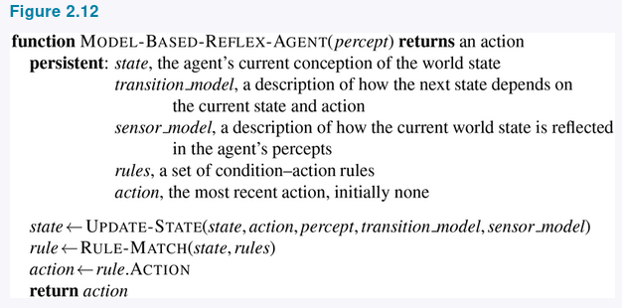
2.4.3 Model-Based Reflex Agent Pseudocode
2.4.3
The interesting step is UPDATE-STATE: combine old state, last action, current percept, transition model, and sensor model.
Partial observability means exact state may be impossible; the agent still must decide.
Figure 2.12
COMP 469 · Chapter 2
21
Notes:
This pseudocode screenshot shows MODEL-BASED-REFLEX-AGENT. The persistent variables include the current internal state, the transition model, the sensor model, rules, and the most recent action. UPDATE-STATE is responsible for producing the new internal state description. The agent then matches a condition-action rule against the internal state rather than just the raw percept.
[Sources]
Uploaded Chapter_2(4).docx, Section 2.4.3 and Figure 2.12.

Slide 22
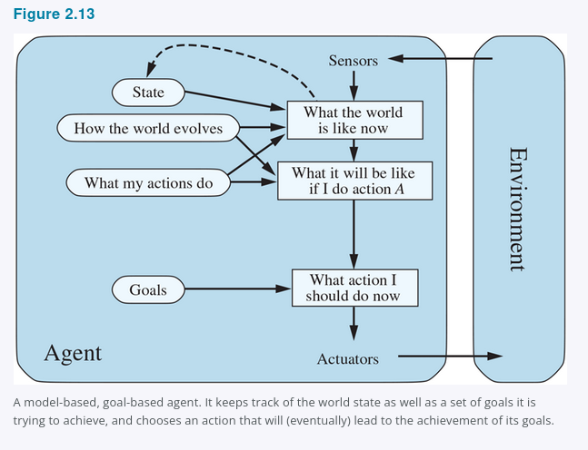
2.4.4 Goal-Based Agents
2.4.4
A current state is not enough; the agent also needs a goal.
Search / planning
Find action sequences that achieve goals. This transitions to Chapters 3-5.
Flexibility
Change the destination, and the same knowledge can support new behavior.
Cost
The agent may need to reason about many possible future action sequences.
Figure 2.13
COMP 469 · Chapter 2
22
Notes:
Goal-based agents add goal information to the current-state estimate. A taxi at an intersection cannot choose left, right, or straight without knowing the destination. This is the bridge to search and planning. The agent considers future states and asks whether its actions will eventually achieve the goal. This is more flexible than reflex rules, but it can be computationally expensive.
[Sources]
Uploaded Chapter_2(4).docx, Section 2.4.4 and Figure 2.13.

Slide 23
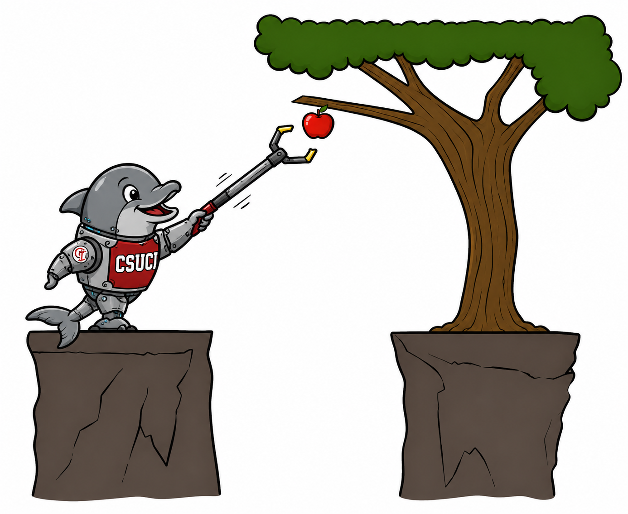
Planning Video Bridge: Reflex vs. Planning
Bridge
Reflex agent
Chooses action from current percept and maybe memory; does not consider future consequences.
Planning agent
Asks “what if?” and chooses actions based on predicted consequences. Must model how the world evolves and must formulate a goal test.
Replanning Pac-Man
Plans a little way ahead, acts, then replans from the new state. This is different from planning once and executing forever.
Key distinction: planning considers how the world WOULD BE, not just how it is now.
Planning distinctions
Optimal vs. complete planning compares best solution quality vs. guaranteed solution finding. Planning vs. replanning compares one long plan vs. repeated look-ahead as the state changes.
COMP 469 · Chapter 2
23
Notes:
Use the planning video only as a bridge. The first segment is useful for Chapter 2 because it compares reflex agents and planning agents and uses Pac-Man as the example. After that, the material becomes Chapter 3 search. Chapter 2 explains why a goal-based agent needs to look ahead; Chapter 3 explains algorithms for doing it.
[Sources]
Uploaded transcript Pasted text(2).txt; uploaded Chapter_2(4).docx, Section 2.4.4.
[Combined from former Slide 24 — Planning Agents]

Slide 24
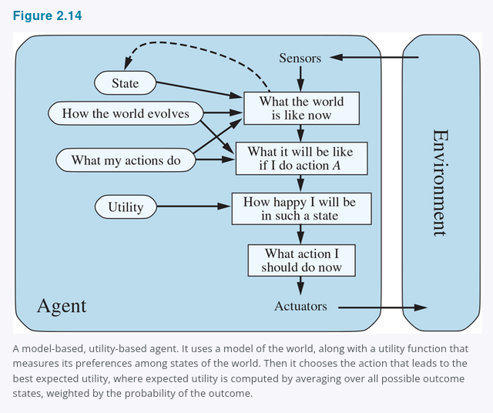
2.4.5 Utility-Based Agents
2.4.5
Goals say whether a state is acceptable; utility ranks how good it is.
Goal-based
Destination reached?
Yes or no.
Utility-based
How good is each outcome?
Fast, safe, comfortable, cheap?
Expected utility
Weigh utility by probability when outcomes are uncertain.
Utility handles conflicts and uncertainty.
Figure 2.14
COMP 469 · Chapter 2
24
Notes:
Utility-based agents are needed when goals are too crude. Many routes can get the taxi to its destination, but some are safer, faster, more reliable, or cheaper than others. Utility allows the agent to compare outcomes by degree. Under uncertainty, a rational utility-based agent chooses the action that maximizes expected utility.
[Sources]
Uploaded Chapter_2(4).docx, Section 2.4.5 and Figure 2.14.

Slide 25
Utility Handles Tradeoffs and Uncertainty
2.4.5
Conflicting goals
Uncertain goals
Expected utility
Speed and safety can conflict. Utility specifies the tradeoff.
Several outcomes may be possible, none guaranteed.
Likelihood of success is weighed against outcome importance.
Utility function = internalization of the performance measure
If the internal utility function and external performance measure agree, maximizing utility supports rational behavior.
Caution: if the utility function is wrong, the agent may optimize the wrong objective.
COMP 469 · Chapter 2
25
Notes:
The chapter emphasizes that utility is an internalization of the performance measure. Utility helps with tradeoffs and uncertainty. It is powerful, but it assumes the utility function is specified correctly. If it is not, the agent may optimize the wrong objective, connecting this chapter to value alignment and unknown utility functions.
[Sources]
Uploaded Chapter_2(4).docx, Section 2.4.5.

Slide 26
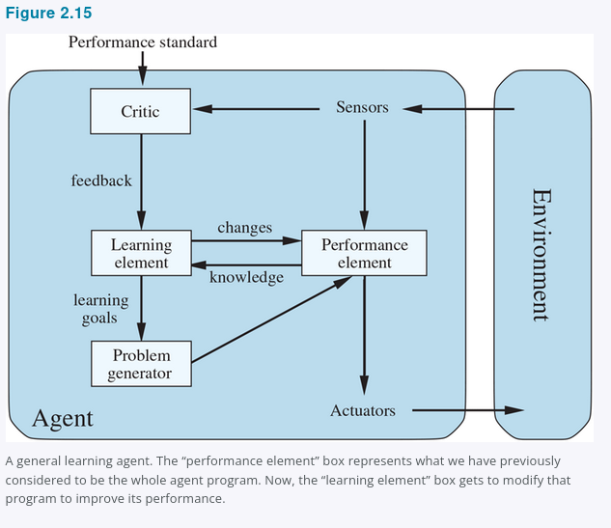
2.4.6 Learning Agents
2.4.6
Any agent type can be made into a learning agent.
Performance element
Selects external actions.
Learning element
Improves the performance element.
Critic
Evaluates behavior against a fixed performance standard.
Problem generator
Suggests exploratory actions for informative experience.
Figure 2.15
COMP 469 · Chapter 2
26
Notes:
Turing argued that hand-programming intelligence is too slow, so learning machines are desirable. Chapter 2 divides a learning agent into four conceptual components: the performance element that selects actions, the learning element that improves behavior, the critic that evaluates performance, and the problem generator that suggests exploratory actions.
[Sources]
Uploaded Chapter_2(4).docx, Section 2.4.6 and Figure 2.15.

Slide 27
Learning Agent Components: What Improves?
2.4.6
Performance element
Transition model
Sensor model
What action should I do now?
What do my actions do?
What percepts should I expect?
Utility / rules
Problem generator
What outcomes should I prefer?
What should I explore next?
Learning modifies agent components to better match feedback and improve performance.
COMP 469 · Chapter 2
27
Notes:
The design of the learning element depends on the performance element. The critic provides feedback relative to a fixed standard. Learning can modify transition models, sensor models, rules, utility functions, and policies. The unifying theme is modification of agent components to better match feedback information.
[Sources]
Uploaded Chapter_2(4).docx, Sections 2.4.6.

Slide 28
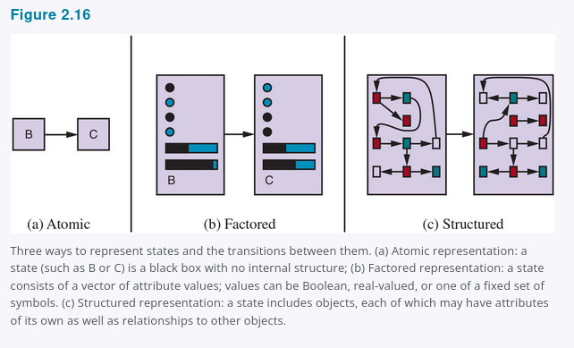
2.4.7 Representing the World Inside the Agent
2.4.7
Atomic
Factored
Structured
State is a black box.
Example: city name only.
Used in search, games, HMMs, MDPs.
State is a set of variables.
Example: location, fuel, speed, weather.
Used in CSPs, logic, Bayes nets, planning.
Objects plus relations.
Example: truck blocking cow near driveway.
Used in first-order logic, databases, language.
less expressive, easier reasoning
more expressive, harder reasoning
Design choice: enough expressive power for the task, but not more than the agent can reason with efficiently.
Figure 2.16
COMP 469 · Chapter 2
28
Notes:
Chapter 2 closes with representations. Atomic representations treat states as indivisible labels. Factored representations break states into variables and values. Structured representations describe objects and relationships. More expressive representations can describe more, often more concisely, but reasoning and learning usually become harder.
[Sources]
Uploaded Chapter_2(4).docx, Section 2.4.7 and Figure 2.16.

Slide 29
All Agent Program Designs in Chapter 2
Synthesis
Table-driven
Simple reflex
Model-based reflex
Stores percept history and looks up an action in a table.
Maps current percept to action using condition-action rules.
Maintains internal state using transition and sensor models.
Goal-based
Utility-based
Learning
Chooses actions by reasoning toward goals.
Ranks outcomes and maximizes expected utility.
Improves components from feedback and experience.
These are design patterns, not rigid boxes. Real systems often combine them.
COMP 469 · Chapter 2
29
Notes:
Use this as a checkpoint. The deck now explicitly covers table-driven, simple reflex, model-based reflex, goal-based, utility-based, and learning agents. Table-driven is included as the conceptual baseline from Section 2.4.1. The other types are the basic agent program designs that Chapter 2 uses to organize the rest of the course.
[Sources]
Uploaded Chapter_2(4).docx, Sections 2.4.1-2.4.6 and Summary.

Slide 30
Choosing an Agent Design from Environment Properties
Synthesis
Fully observable + simple
Partially observable
Simple reflex
Fast condition-action rules may be enough.
Model-based reflex
Maintain internal state and update it using models.
Long-term objective
Tradeoffs / uncertainty
Goal-based
Search or planning over future action sequences.
Utility-based
Compare outcomes by expected utility.
Unknown rules / changing world
Learning agent
Improve model, utility, rules, or policy from feedback.
COMP 469 · Chapter 2
30
Notes:
This is the practical synthesis slide. The agent design follows from the task environment. Fully observable and simple settings can sometimes use simple reflex rules. Partial observability pushes toward model-based agents. Long-term objectives push toward goal-based agents and search. Tradeoffs and uncertainty push toward utility-based agents. Unknown or changing environments push toward learning.
[Sources]
Uploaded Chapter_2(4).docx, Sections 2.3.2 and 2.4.

Slide 31
Class Activity: Build a PEAS Description
Activity
Choose one system, then fill in PEAS before proposing an algorithm.
Autonomous Pac-Man
Campus chatbot
Email phishing triage agent
Robotic delivery cart
Performance
Environment
Students write 2-3 concrete items.
Students write 2-3 concrete items.
Actuators
Sensors
Students write 2-3 concrete items.
Students write 2-3 concrete items.
Instructor checkpoint: if students cannot define PEAS, they are not ready to design the agent.
COMP 469 · Chapter 2
31
Notes:
Divide the class into small groups. Assign a system and ask each group to fill in PEAS. The checkpoint is important: if students cannot define PEAS, they are not ready to propose algorithms. This prevents students from jumping straight to implementation before specifying the task environment.
[Sources]
Uploaded Chapter_2(4).docx, Section 2.3.1.

Slide 32
Class Demo: Autonomous Pac-Man Agent
Demo
Use the game to make the Chapter 2 vocabulary operational.
What are the percepts?
What actions can the agent return?
What is the performance measure?
Does it use memory or only current state?
Is it reflex, model-based, goal-based, utility-based, or mixed?
Transition: search algorithms are one way to make goal-based agents act rationally.
COMP 469 · Chapter 2
32
Notes:
Run the autonomous Pac-Man game here. Ask students to map the code to Chapter 2 vocabulary. Percepts are position, legal moves, pellets, power pellets, and ghost positions. Actions are movement commands. The performance measure is score, survival, and completion. Ask whether the code is reflex, model-based, goal-based, utility-based, or mixed. The answer can be mixed.
[Sources]
Uploaded Chapter_2(4).docx, Sections 2.1-2.4.

Slide 33
How the Planning Video Fits Your Lecture
Video
Use for Chapter 2
Save for Chapter 3
1:19-10:05: agents that plan, reflex agents, Pac-Man examples, planning versus replanning.
After ~11:48: search problem formulation, state spaces, search trees, DFS, BFS, UCS.
Teaching boundary
Chapter 2 explains what a goal-based agent is. Chapter 3 explains how search implements it.
Recommended use: play the first segment as a bridge, then stop before the full search algorithms.
COMP 469 · Chapter 2
33
Notes:
The planning video is useful, but not all of it is Chapter 2. The first segment supports Chapter 2 because it distinguishes reflex agents from planning agents and uses Pac-Man as the example. After that, the lecture becomes Chapter 3. Use it as a bridge: Chapter 2 explains why a goal-based agent needs to look ahead; Chapter 3 explains the search algorithms for doing so.
[Sources]
Uploaded transcript Pasted text(2).txt; uploaded Chapter_2(4).docx, Section 2.4.4.

Slide 34
Chapter 2 Takeaways
Summary
An agent perceives an environment through sensors and acts through actuators.
A rational agent maximizes expected performance, not hindsight perfection.
PEAS specifies the task: performance, environment, actuators, sensors.
Environment properties determine which agent design is appropriate.
Agent programs include table-driven, simple reflex, model-based, goal-based, utility-based, and learning agents.
Representations determine what the agent can express and how hard reasoning becomes.
Define the agent -> Specify the task -> Classify the environment -> Choose the design
COMP 469 · Chapter 2
34
Notes:
Close with the chapter logic. First define the agent and environment. Second specify the task with PEAS. Third classify the environment. Fourth choose an agent program design. A table-driven agent is the conceptual baseline but not practical. Simple reflex agents are fast and brittle. Model-based agents handle hidden state. Goal-based agents reason toward goals. Utility-based agents handle tradeoffs and uncertainty. Learning agents improve from feedback.
[Sources]
Uploaded Chapter_2(4).docx, Summary.

